Slide 1
🐍
Python
Data Fundamentals
Complete Beginner-to-Practitioner Teaching Deck
Platform: Google Colab | No installation required
Data Types
Operators
Data Structures
KAJOLA GBENGA ADEWALE
Data Analytics Expert
if / elif / else
for Loops
while Loops
Functions
Business Use Cases
30 Challenges
Notes:
Welcome. Introduce yourself: Kajola Gbenga Adewale, Data Analytics Expert. Tell students: everything we do today is on Google Colab — no installation, no setup, works on any device including your phone. This deck covers every Python fundamental needed to start working with real data. We also show real business applications for every topic.

Slide 2
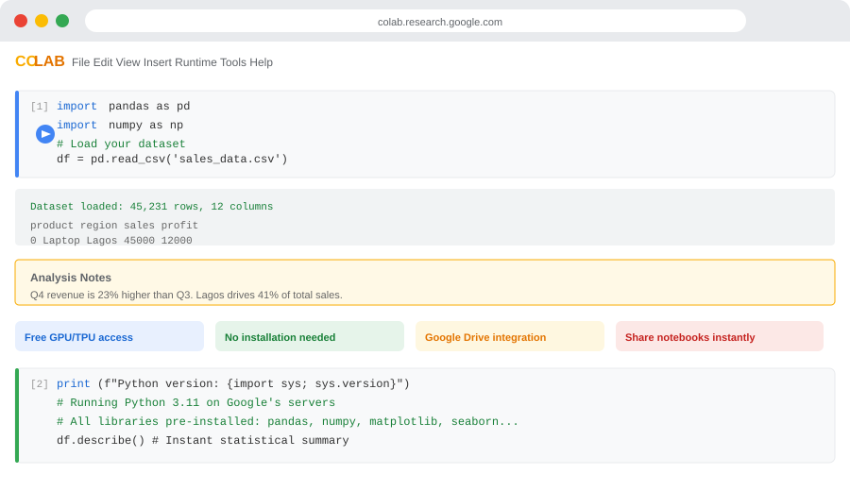
GOOGLE COLAB — YOUR FREE PYTHON ENVIRONMENT
Step 1: Open Colab
Go to colab.research.google.com. Sign in with any Google account. It is completely free.
Step 2: New Notebook
Click "File → New Notebook". A blank .ipynb file opens instantly.
Step 3: Write Code
Click any cell. Type your Python code. Press Shift+Enter to run it.
Step 4: See Results
Output appears directly below the cell. Errors show in red with explanations.
Step 5: Save + Share
Saves automatically to Google Drive. Share link with teammates instantly.
What is pre-installed
NumPy, Pandas, Matplotlib, Seaborn, Scikit-Learn, TensorFlow — all ready to use.
Notes:
Walk every student through opening Colab live. Have them create a new notebook. Run a first cell: print('Hello, class!'). Confirm all outputs show correctly before proceeding. This is the most important setup step — everyone must have a running cell before we continue.

Slide 3
SESSION CONTENTS — WHAT WE COVER TODAY
01
Setup — Google Colab and Your First Cell
05
if / elif / else — Conditional Logic
02
Data Types — int, float, str, bool, None
06
Loops — for, while, break, continue
03
Operators — Arithmetic, Comparison, Logical
07
Functions — def, parameters, scope, lambda
04
Data Structures — list, tuple, dict, set
08
Practical Projects and 30-Question Exercise Bank
Notes:
Session roadmap. All eight sections build on each other. Tell students to follow in order on their first pass. Section 08 has 30 exercises graded by difficulty — beginners do Q1-10, intermediate Q11-20, advanced Q21-30.

Slide 4
01
Setup and First Program
Everything runs in Google Colab. Zero installation.

Slide 5
YOUR FIRST PYTHON CELL IN GOOGLE COLAB
first_program.py
No semicolons
# CELL 1 — Type this. Press Shift+Enter to run.
print("Hello, World!")
# Output: Hello, World!
# CELL 2 — Variables store data
product = 'Laptop Pro' # text (str)
units_sold = 250 # whole number (int)
unit_price = 450_000.00 # decimal (float)
in_stock = True # yes/no (bool)
discount = None # not set yet (NoneType)
# CELL 3 — Print with context
print("Product:", product)
print("Units:", units_sold)
print("Revenue:", units_sold * unit_price)
# Output: Revenue: 112500000.0
# CELL 4 — f-strings (modern way)
print(f"Product: {product}")
print(f"Revenue: NGN {units_sold * unit_price:,.0f}")
# Output: Revenue: NGN 112,500,000
# CELL 5 — Check the type of any variable
print(type(product)) # <class "str">
print(type(units_sold)) # <class "int">
print(type(in_stock)) # <class "bool">
Lines end at the newline. No ; needed. Whitespace is the structure.
Case-sensitive
product, Product, PRODUCT are three different variables.
Indentation = structure
4 spaces (or 1 Tab) define code blocks. Inconsistency causes IndentationError.
# is a comment
Python ignores everything after # on a line. Use comments to explain.
Shift+Enter to run
In Colab, Shift+Enter runs the current cell and moves to the next.
Notes:
IMPORTANT: All examples use generic business variables — product, price, units, region, etc. No personal names or ages in code examples. Walk each cell slowly. Have every student run Cell 4 first to see the comma-formatted revenue. This always gets a positive reaction.

Slide 6
02
Data Types
What kind of information is this — and what can we do with it?

Slide 7
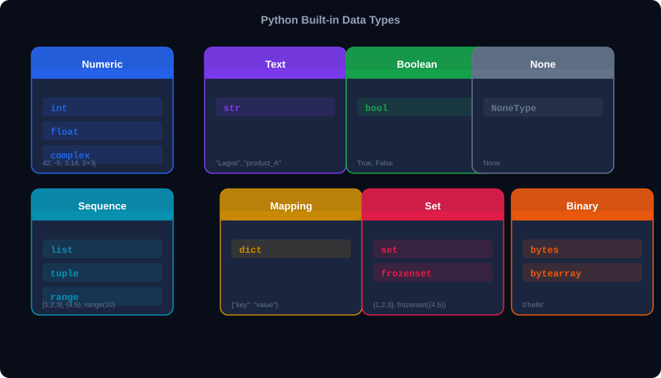
PYTHON DATA TYPES — THE COMPLETE PICTURE
Notes:
The type map. Focus on the top row (primitive types) and middle row (collection types). The bottom row (abstract base classes) is for reference. Tell students: every piece of data in Python has a type. The type determines what you can do with the data — add numbers, slice strings, look up dict keys, etc.

Slide 8
int AND float — WORKING WITH NUMBERS
numeric.py
Division always returns float
# INTEGER — whole numbers
quantity = 500
tax_percent = 7
population = 216_000_000 # underscores OK
# FLOAT — decimal numbers
unit_price = 2_500.50
vat_rate = 0.075
exchange = 1_580.25
# Arithmetic — all division types
200 / 3 # 66.666... (float div)
200 // 3 # 66 (integer division)
200 % 3 # 2 (remainder)
2 ** 10 # 1024 (power)
# Type casting
int(3.9) # 3 (truncates, not rounds!)
float(500) # 500.0
round(3.14159, 2) # 3.14
# Business calculation
revenue = quantity * unit_price
tax = revenue * vat_rate
total = revenue + tax
print(f"Total: NGN {total:,.2f}")
7 / 2 = 3.5 not 3. Use // if you want integer division.
int() truncates
int(3.9) is 3, not 4. Use round() to round to nearest integer.
Underscores in numbers
1_000_000 is cleaner than 1000000. Python ignores the underscores.
Float precision
0.1 + 0.2 is NOT exactly 0.3 (binary arithmetic). Use round() for money.
abs() min() max() sum()
Built-in functions that work on numbers: abs(-5)=5, max(3,7,2)=7
Notes:
Numeric types. The critical distinction: 7/2 gives 3.5 (float), while 7//2 gives 3 (floor division). Show the NGN revenue calculation running live in Colab. The {:,.2f} format specifier for comma-separated NGN values is immediately practical.

Slide 9
str — TEXT DATA AND STRING MANIPULATION
strings.py
Key String Methods
# Creating strings
company = 'TechVentures Ltd'
address = "14 Broad Street, Lagos"
report = """Q4 Analysis:
Revenue up 18%. Costs stable."""
# f-strings — best practice
region = 'South-West'
revenue = 4_500_000
print(f"{region}: NGN {revenue:,}")
# South-West: NGN 4,500,000
# Indexing and slicing
code = 'PROD-2024-001'
code[0] # 'P' (first character)
code[-1] # '1' (last character)
code[5:9] # '2024' (slice: chars 5-8)
code[:4] # 'PROD' (from start to 4)
code[::-1] # '100-4202-DORP' (reversed)
# Strings are immutable
code[0] = 'X' # TypeError — cannot change!
new = 'X' + code[1:] # correct: build new
# Common methods
company.upper() # 'TECHVENTURES LTD'
company.replace('Ltd','Plc') # update name
address.split(',') # ['14 Broad Street',' Lagos']
.upper() / .lower()
Case conversion for normalising data
.strip()
Remove leading/trailing whitespace from inputs
.split(delim)
Split CSV row into fields by delimiter
.replace(old,new)
Find-and-replace in text fields
.startswith()/endswith()
Check prefix/suffix (file types, IDs)
.find(sub)
Returns index of substring, -1 if absent
len(string)
Count characters — validate field length
f'{var:.2f}'
Format float in f-string to 2 decimal places
','.join(lst)
Join list back into comma-separated string
.zfill(n)
Pad with zeros: '7'.zfill(5) = '00007'
Notes:
Strings. All examples use business context: company names, product codes, addresses. The product code slicing example (PROD-2024-001) is realistic — analysts often need to extract year, category, or sequence number from coded fields. .zfill() is used for invoice numbers, employee IDs, etc.

Slide 10
bool AND None — TRUE/FALSE AND ABSENT VALUES
booleans.py
FALSY — evaluates to False
TRUTHY — evaluates to True
# Boolean — only True or False
is_active = True
is_overdue = False
has_paid = True
# Booleans from comparisons
500 > 300 # True
revenue == target # True or False
stock == 0 # True when out of stock
# Truthy and Falsy (critical!)
bool(0) # False (zero is falsy)
bool(100) # True
bool("") # False (empty string)
bool("pending") # True
bool([]) # False (empty list)
bool(None) # False
# None — represents no value / missing
approval_date = None # not approved yet
if approval_date is None:
print("Pending approval")
0 (zero integer)
Any non-zero number
0.0 (zero float)
Any non-empty string
"" (empty string)
Non-empty list or dict
[] (empty list)
Non-empty set or tuple
{} (empty dict)
True
() (empty tuple)
Any object by default
None
False
Important: use 'is None' not '== None'
'is None' checks identity (same object). '== None' checks equality. Both work but 'is None' is the professional Python style.
Notes:
Bool and None. The truthy/falsy concept has massive practical importance. In data work: 'if customer_list:' is cleaner than 'if len(customer_list) > 0:'. None is the most common value for missing data before Pandas NaN is introduced. Demonstrate each case in Colab.

Slide 11
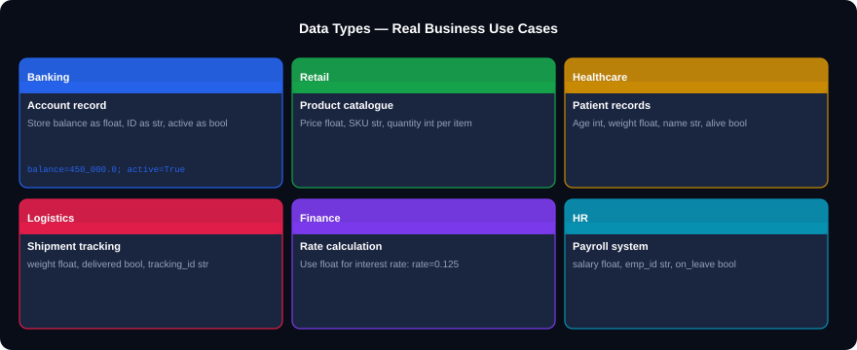
DATA TYPES IN BUSINESS — REAL APPLICATIONS
Notes:
Data types use cases. Point out: in healthcare, storing weight as int vs float matters (80 kg vs 80.5 kg). In banking, float rounding errors can cause compliance issues — always round financial values. In HR, using bool for on_leave is cleaner than storing 'yes'/'no' strings.

Slide 12
SECTION 02 CHALLENGE — DATA TYPES
⚡ CHALLENGE
⚡ CHALLENGE
Q1. Create variables for a product record:
- name (str), quantity (int), price (float), available (bool), last_sold (None)
Print each with its type().
Q2. What does int(7.9) return?
What about int(-7.9)?
How do you round 7.9 to the nearest integer?
Answer:
Answer:
name='Laptop'; qty=50; price=450000.0
available=True; last_sold=None
print(type(name), type(qty), type(price))
int(7.9) = 7 (truncates down)
int(-7.9) = -7 (truncates toward zero)
round(7.9) = 8 (nearest integer)
⚡ CHALLENGE
⚡ CHALLENGE
Q3. Which of these evaluate to False?
500, 0, '', 'False', [], None, 0.0, [0]
Q4. A cashier types the total as input.
Write ONE LINE that stores it as a float.
Answer:
Answer:
Falsy: 0, '', [], None, 0.0
Truthy: 500, 'False', [0]
Remember: any non-empty container is truthy!
total = float(input('Enter total: '))
# input() always returns str
# float() converts it to decimal
Notes:
Challenge 1. Give 6 minutes. Q3 (truthy/falsy) is the one that surprises most students. Q4 is the most practically important — input() returning a string is a common beginner trap.

Slide 13
03
Operators
How Python computes, compares, and combines values.

Slide 14
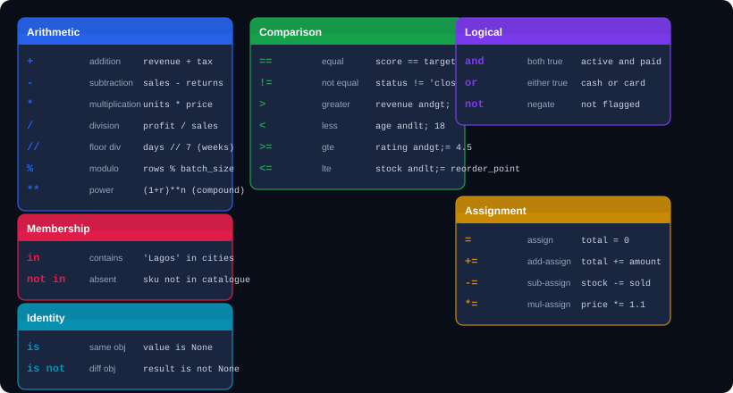
ALL PYTHON OPERATORS — WITH BUSINESS EXAMPLES
Notes:
Operators grid. Every example uses business context: revenue + tax, sales - returns, units * price, profit / sales, days // 7 for weeks, rows % batch_size for remainder after batching. The % operator is used heavily in data pipelines to split datasets into batches. ** is used in compound interest calculations.

Slide 15
OPERATORS IN PRACTICE — BUSINESS CALCULATIONS
operators_business.py
Operator Precedence
# Financial calculations
revenue = 5_000_000
costs = 3_200_000
vat_rate = 0.075
profit = revenue - costs # 1,800,000
margin_pct = (profit/revenue)*100 # 36.0%
vat_amount = revenue * vat_rate # 375,000
# Compound interest: A = P(1+r/n)^(nt)
principal = 1_000_000
rate = 0.12 # 12% annual
periods = 12 # monthly compounding
years = 3
final = principal * (1 + rate/periods)**(periods*years)
print(f"After 3 years: NGN {final:,.0f}")
# Comparison in conditions
stock = 15
reorder_point = 20
needs_reorder = stock <= reorder_point # True
# Logical operators
eligible = age >= 21 and income >= 50_000
pay_method = card_valid or cash_available
is_new = not has_account
# Membership operator
region = 'South-West'
allowed = region in ['South-West','North-Central']
1 (first)
( )
Parentheses — always first
2
**
Exponentiation — right to left
3
* / // %
Multiply, divide, floor, remainder
4
+ -
Addition and subtraction
5
< <= > >= == !=
Comparisons
6
not
Boolean NOT
7
and
Boolean AND
8 (last)
or
Boolean OR
Notes:
Operators in practice. The compound interest formula is immediately recognisable to finance students. Run it live in Colab. Also show the stock reorder logic — this is a real retail automation pattern. The eligibility check (age AND income) mirrors loan approval systems.

Slide 16
SECTION 03 CHALLENGE — OPERATORS
⚡ CHALLENGE
⚡ CHALLENGE
Q1. A store buys 200 units at NGN 3,500 each.
VAT is 7.5%. Shipping is NGN 15,000.
Calculate total cost in one expression.
Q2. What is the output?
x = 17
print(x // 5)
print(x % 5)
print(x / 5)
Answer:
Answer:
total = 200 * 3500 * 1.075 + 15000
# = 752,500 + 15,000 = 767,500
print(f'NGN {total:,.0f}')
x // 5 = 3 (17 divided by 5 = 3 remainder)
x % 5 = 2 (the remainder is 2)
x / 5 = 3.4 (float division)
⚡ CHALLENGE
⚡ CHALLENGE
Q3. A loan is approved if:
- Age is between 21 and 60 AND
- Monthly income > 50,000
Write the condition for age=35, income=75000.
Q4. NGN 1,000,000 is invested at 15% per year,
compounded monthly. What is it worth after 2 years?
Use: A = P * (1 + r/n)**(n*t)
Answer:
Answer:
approved = (21 <= age <= 60) and income > 50000
# True — age chaining works in Python!
P=1_000_000; r=0.15; n=12; t=2
A = P * (1 + r/n)**(n*t)
print(f'NGN {A:,.0f}') # NGN 1,347,351
Notes:
Challenge 2. Q1 forces correct operator precedence with parentheses. Q3 introduces Python's chained comparison (21 <= age <= 60) which is unique and elegant. Q4 is a real financial formula students in banking and finance will appreciate.

Slide 17
04
Data Structures
list | tuple | dict | set

Slide 18
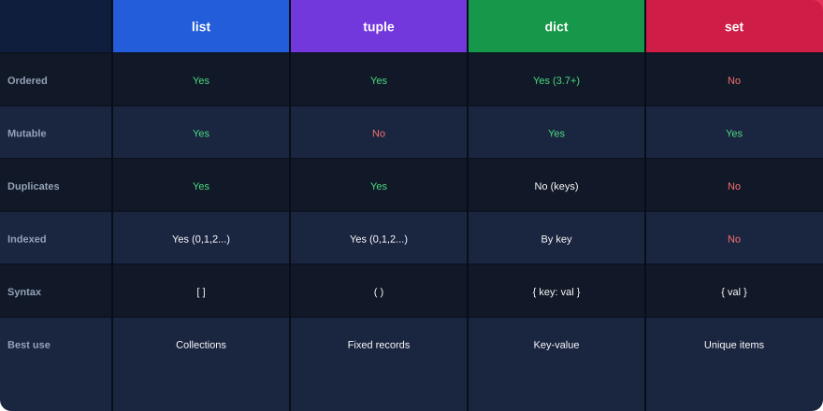
FOUR STRUCTURES — SIDE BY SIDE
Notes:
Comparison grid. Print this for students — it is the most referenced single slide. The decision rule: need to change items? If No → tuple. Need to look up by name? Yes → dict. Need uniqueness guaranteed? Yes → set. Otherwise → list.

Slide 19
list — ORDERED, CHANGEABLE COLLECTIONS
lists.py
List Methods Quick Reference
# Creating lists
products = ['Laptop','Phone','Tablet','Monitor']
revenues = [450_000, 120_000, 85_000, 200_000]
mixed = ['Q1', 45, True, None] # mixed OK
# Indexing and slicing
products[0] # 'Laptop' (first item)
products[-1] # 'Monitor' (last item)
products[1:3] # ['Phone','Tablet']
products[::-1] # reversed list
# Modifying lists
products.append('Router') # add to end
products.insert(1, 'Speaker') # insert at 1
products.remove('Tablet') # remove by value
sold = products.pop(0) # remove first
products[0] = 'Gaming Laptop' # update in place
# Useful operations
len(products) # count
'Phone' in products # True/False
sum(revenues) # total
max(revenues) # highest
sorted(revenues, reverse=True) # ranked
revenues.sort() # sort in-place
.append(x)
Add x to end
.extend([a,b])
Add all items from another list
.insert(i, x)
Insert x at position i
.remove(x)
Remove first occurrence of x
.pop(i)
Remove and return item at index i
.sort()
Sort in place (ascending)
.reverse()
Reverse in place
.index(x)
Return index of first x
.count(x)
Count occurrences of x
.copy()
Return shallow copy
.clear()
Remove all items
sorted(lst)
Return new sorted list (non-destructive)
Notes:
Lists. Business context throughout. sorted(revenues, reverse=True) gives a sales leaderboard. 'Phone' in products is a stock check. pop(0) removes and returns the first item — used in queue patterns for processing orders.

Slide 20
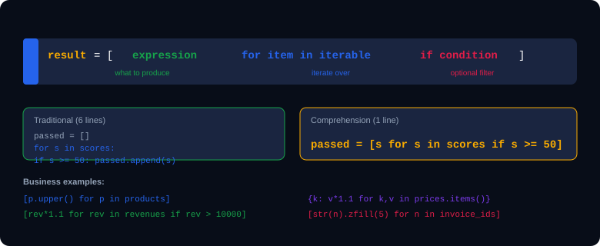
LIST COMPREHENSIONS — PYTHONIC DATA TRANSFORMATION
comprehensions.py
# Practical examples in Colab
prices = [12000, 35000, 8500, 42000, 5000]
# Apply 10% discount to items over 10,000
discounted = [p*0.9 if p>10000 else p for p in prices]
# Normalise product names to title case
clean_names = [n.strip().title() for n in raw_names]
Notes:
List comprehensions. The business pattern 'apply discount if condition else keep original' is the ternary expression inside a comprehension — a very common ETL pattern. .strip().title() is the standard string normalisation pattern for cleaning user-entered data.

Slide 21
tuple — ORDERED AND IMMUTABLE (FIXED DATA)
tuples.py
Why tuples, not lists?
# Creating tuples
coordinates = (6.4541, 3.3947) # Lagos lat/lon
rgb_colour = (255, 165, 0) # orange
quarter = ('Q1', 2024, 'Jan')
single = (42,) # need the comma!
# Cannot modify — immutable
coordinates[0] = 7.0 # TypeError!
# Tuple unpacking — very powerful
lat, lon = coordinates
q, year, month = quarter
# Functions often return tuples
def min_max_revenue(data):
return min(data), max(data)
lo, hi = min_max_revenue(revenues)
# lo = 5000, hi = 450000
# Pythonic swap
a, b = 100, 200
a, b = b, a # a=200, b=100
# Tuples as dict keys
sales = {('Lagos','Q1'): 4_500_000,
('Abuja','Q1'): 2_100_000}
Tuples signal 'this data will not change'. Faster to iterate. Can be used as dictionary keys (lists cannot). Protects fixed records from accidental mutation.
Unpacking in loops
for region, revenue in region_data:
print(f'{region}: {revenue:,}')
Unpacking multiple return values at once.
Named tuples
from collections import namedtuple
Product = namedtuple('Product',['name','price'])
p = Product('Laptop',450000)
p.price # 450000
Common in data work
pd.DataFrame.itertuples() returns rows as named tuples. min_max, divmod(), and many Pandas/NumPy functions return tuples.
Notes:
Tuples. The unpacking pattern is everywhere in real data code. The (region, quarter) composite dict key is a real pattern used in financial dashboards where you need to look up values by two dimensions. Named tuples bridge tuples and classes — mention it briefly for advanced students.

Slide 22
dict — KEY-VALUE PAIRS FOR STRUCTURED DATA
dicts.py
Dictionary Methods
# Creating dictionaries
customer = {
"id": "CUST-00142",
"company": "Allied Foods Ltd",
"region": "South-West",
"balance": 1_250_000.00,
"overdue": False
}
# Access values
customer["company"] # "Allied Foods Ltd"
customer.get("rating", "N/A") # default value
# Modify
customer["balance"] = 980_000 # update
customer["credit_limit"] = 2_000_000 # add key
del customer["overdue"] # remove key
# Iterate
for key, value in customer.items():
print(f" {key}: {value}")
# Dict comprehension — transform all values
prices = {'Laptop':400000,'Phone':120000}
# Apply 5% increase to all prices
new_prices = {k: v*1.05 for k,v in prices.items()}
.keys()
All keys as a view
.values()
All values as a view
.items()
(key, value) pairs — for loops
.get(k, default)
Safe access — never KeyError
.update(other)
Merge another dict
.pop(k)
Remove and return value
.setdefault(k,v)
Set only if key absent
k in d
Check if key exists
len(d)
Number of key-value pairs
dict(zip(k,v))
Build dict from two lists
Notes:
Dictionaries. The customer record is a realistic CRM structure. .get() is critical — use it whenever a key might be absent (optional fields, user-entered data). The dict comprehension for price updates is a real ETL pattern. dict(zip(keys,values)) builds a dict from two parallel lists — very common.

Slide 23
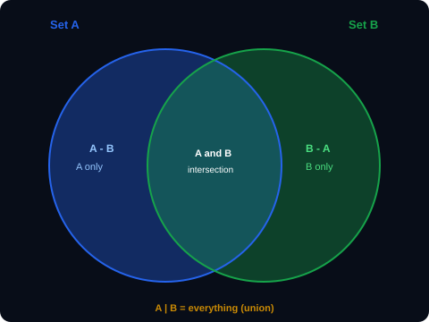
set — UNIQUE ITEMS AND SET OPERATIONS
sets.py
# Creating sets
active_regions = {'Lagos','Abuja','Kano','Ibadan'}
visited = {'Lagos','Kano','Port Harcourt'}
# Duplicates are removed automatically
items = [1, 2, 2, 3, 3, 3, 4]
unique_items = set(items) # {1, 2, 3, 4}
# Set operations — very powerful
# Regions in BOTH lists
in_both = active_regions and visited
both = active_regions & visited # {'Lagos','Kano'}
# Active but NOT yet visited
not_visited = active_regions - visited
# {'Abuja','Ibadan'}
# Either or both (union)
all_regions = active_regions | visited
# Fast membership check
'Lagos' in active_regions # O(1) — instant
When to use sets in data work
Remove duplicates from a list: list(set(my_list))
Find common customers in two datasets: set_a & set_b
Find customers who lapsed: previous - current
Fast membership check (O(1) vs O(n) for lists)
Notes:
Sets. The region operations are immediately recognisable in CRM and sales territory analysis. The O(1) membership check is critical for large datasets — checking if an ID is in a set of 1 million items takes the same time as checking a set of 10 items.

Slide 24

DATA STRUCTURES IN BUSINESS — REAL APPLICATIONS
Notes:
Data structure use cases. Each structure has a natural fit: list for ordered transaction history, tuple for geographic coordinates and fixed records, dict for customer records and inventory lookup, set for deduplication and territory analysis. The wrong choice causes bugs — mutable tuple attempts, KeyError crashes, duplicate records.

Slide 25
SECTION 04 CHALLENGE — DATA STRUCTURES
⚡ CHALLENGE
⚡ CHALLENGE
Q1. Given:
scores = [45,78,32,91,65,50,88]
Use a list comprehension to return ONLY the scores above 60, each increased by 5% bonus.
Q2. You have:
product_names = ['laptop','phone','tablet']
prices = [450000, 120000, 85000]
Build a dictionary mapping each name to its price.
Answer:
Answer:
[round(s*1.05,1) for s in scores if s > 60]
# [81.9, 95.55, 68.25, 92.4]
catalogue = dict(zip(product_names, prices))
# {'laptop':450000,'phone':120000,'tablet':85000}
⚡ CHALLENGE
⚡ CHALLENGE
Q3. You have two customer lists:
batch_jan = ['C001','C002','C003','C004']
batch_feb = ['C003','C004','C005','C006']
Find: (a) customers in both months
(b) customers only in January
Q4. Build a dict comprehension that takes:
prices = {'Rice':3000,'Beans':2500,'Yam':1800}
and returns a new dict with all prices increased by 12% VAT.
Answer:
Answer:
both = set(batch_jan) & set(batch_feb) # {C003,C004}
june_only = set(batch_jan) - set(batch_feb) # {C001,C002}
{item: round(p*1.12,2) for item,p in prices.items()}
# {'Rice':3360.0,'Beans':2800.0,'Yam':2016.0}
Notes:
Data structures challenge. Q2 uses dict(zip()) — a common interview question. Q3 uses set operations on customer IDs — this is exactly how CRM analysts find churned vs retained customers. Q4 uses dict comprehension for price updates — standard for seasonal repricing or tax changes.

Slide 26
05
if / elif / else
Making your code respond to different situations.

Slide 27
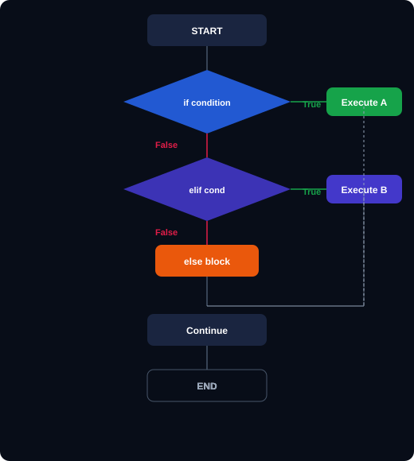
IF / ELIF / ELSE — HOW CONDITIONAL LOGIC FLOWS
conditionals.py
# Simple if
stock = 8
if stock <= 10:
print("Reorder needed")
# if / else
balance = 250_000
if balance >= 500_000:
tier = "Platinum"
else:
tier = "Standard"
# if / elif / else — credit rating
score = 720
if score >= 750:
rating = "Excellent"
elif score >= 700:
rating = "Good"
elif score >= 650:
rating = "Fair"
else:
rating = "Poor"
print(f"Score {score}: {rating}")
# Ternary — one-line if/else
status = 'Active' if balance > 0 else 'Inactive'
# Nested
if score >= 700:
if income >= 100_000:
print("Premium loan approved")
else:
print("Standard loan approved")
Notes:
Conditionals. All examples are business-realistic: stock reorder point, customer tier based on balance, credit score rating, active/inactive account. The credit score elif chain is a direct analogue of real credit bureau rating systems used by Nigerian banks.

Slide 28
COMPOUND CONDITIONS — and, or, not
compound_conditions.py
Truth Tables
# and — ALL conditions must be True
age = 35
income = 120_000
credit = 710
if age >= 21 and income >= 50_000 and credit >= 700:
print("Loan APPROVED")
# or — ANY condition being True is enough
payment_mode = 'transfer'
if payment_mode == 'cash' or payment_mode == 'transfer':
print("Payment accepted")
# Cleaner version:
if payment_mode in ('cash','transfer','POS','USSD'):
print("Payment accepted")
# not — reverse the boolean
account_verified = False
if not account_verified:
print("Please verify your account first")
# Chained comparison — Pythonic!
if 18 <= age <= 65:
print("Eligible")
# Equivalent to: age >= 18 and age <= 65
# Real fraud detection rule
if amount > 1_000_000 or (foreign and amount > 100_000):
flag_for_review(transaction)
A
B
A and B
A or B
not A
True
True
True
True
False
True
False
False
True
False
False
True
False
True
True
False
False
False
False
True
Fraud detection pattern
Combining amount threshold with a foreign transaction flag is exactly how many Nigerian fintech companies implement their first fraud rules.
Membership check beats 'or' chains
'Lagos' in allowed_regions is cleaner than region=='Lagos' or region=='Kano'. Easier to maintain — just update the list.
Notes:
Compound conditions. The fraud detection rule at the bottom is a real pattern used in payment systems. Walk through it slowly: flag if amount exceeds one million, OR if it's a foreign transaction exceeding 100k. The 'in' membership check for payment modes is a pattern worth emphasising.

Slide 29
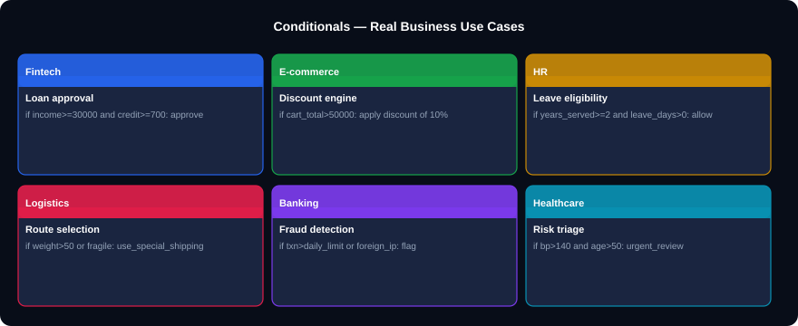
CONDITIONALS IN BUSINESS — REAL APPLICATIONS
Notes:
Conditional use cases. These six industries all depend on if/elif/else at their core. Loan approval, e-commerce discounting, leave eligibility, shipping routing, fraud flagging, and clinical triage — all are decision trees implemented as conditional logic. Python conditionals ARE business rules.

Slide 30
SECTION 05 CHALLENGE — CONDITIONALS
⚡ CHALLENGE
⚡ CHALLENGE
Q1. Write a grade classifier:
90+ = A, 80-89 = B, 70-79 = C
60-69 = D, below 60 = F
Test with score = 77.
Q2. A store offers tiered discounts:
- Spend over 100,000 → 15% off
- Spend over 50,000 → 10% off
- Spend over 20,000 → 5% off
- Otherwise → no discount
Calculate for spend = 67,500.
Answer:
Answer:
if score>=90: grade='A'
elif score>=80: grade='B'
elif score>=70: grade='C'
elif score>=60: grade='D'
else: grade='F' # output: C
if spend>100000: disc=0.15
elif spend>50000: disc=0.10
elif spend>20000: disc=0.05
else: disc=0.0
final = spend*(1-disc) # 60,750
⚡ CHALLENGE
⚡ CHALLENGE
Q3. Without running it, predict the output:
transaction = 850_000
foreign = False
if transaction > 1_000_000 or (foreign and transaction > 100_000):
print('Flagged')
else:
print('Cleared')
Q4. Rewrite this as a ternary:
if account_balance >= 100_000:
risk_level = 'Low'
else:
risk_level = 'High'
Answer:
Answer:
Output: Cleared
850,000 < 1,000,000 (first condition False)
foreign is False so second condition skips
Neither True, so else runs.
risk_level = 'Low' if account_balance >= 100_000 else 'High'
# One line, same result — very readable.
Notes:
Conditionals challenge. Q2 (tiered discounts) is important — students must order conditions from highest to lowest threshold, otherwise wrong discounts get applied. Q3 (predict without running) tests genuine understanding of logical operators. Q4 reinforces the ternary pattern.

Slide 31
06
Loops
Process hundreds of thousands of records in seconds.

Slide 32
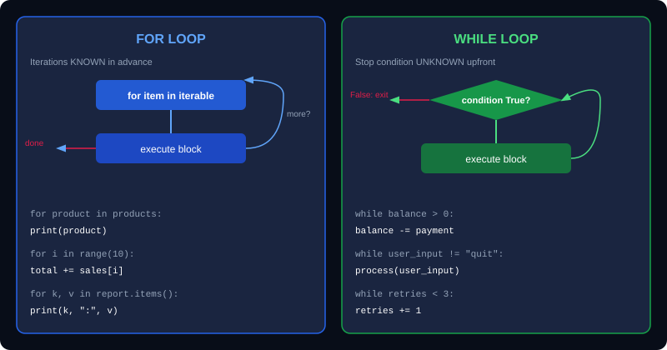
FOR LOOP vs WHILE LOOP
Notes:
The loop comparison diagram. Rule of thumb: if you know in advance how many times to iterate, use for. If you repeat until something changes (user input, API response, error retry), use while. In data analytics, for loops dominate — iterating over rows, columns, files, and dictionary items.

Slide 33
THE for LOOP — EVERY PATTERN YOU NEED
for_loops.py
range(start, stop, step)
# Iterate over a list
products = ['Laptop','Phone','Tablet','Monitor']
for product in products:
print(f"Processing: {product}")
# range — generate numbers
for i in range(5): # 0 1 2 3 4
for i in range(1, 6): # 1 2 3 4 5
for i in range(0,10,2): # 0 2 4 6 8 (step=2)
for i in range(10,0,-1): # 10 9 8 ... 1
# enumerate — get index AND value
for rank, product in enumerate(products, 1):
print(f"#{rank}: {product}")
# zip — iterate two lists in sync
regions = ['Lagos','Abuja','Kano']
revenues = [4_500_000, 2_100_000, 1_800_000]
for region, rev in zip(regions, revenues):
print(f"{region}: NGN {rev:,}")
# Iterate over dict
report = {'Q1':4.2,'Q2':5.1,'Q3':3.8,'Q4':6.0}
for quarter, revenue in report.items():
print(f"{quarter}: NGN {revenue}M")
# Accumulate with a loop
total = 0
for rev in revenues:
total += rev
print(f"Total: NGN {total:,}")
Generates numbers from start up to (not including) stop, jumping by step. range(1,13) gives months 1-12.
enumerate(iterable, start=0)
Yields (index, value) pairs. Cleaner than range(len(lst)). Use start=1 for human-readable ranking.
zip(list1, list2)
Pairs items from two lists. Stops at the shorter one. Use for parallel columns of data.
dict.items()
Returns (key, value) pairs for iteration. The standard way to loop over every field in a record.
Notes:
For loops. The zip(regions, revenues) example is immediately practical — this is exactly how analysts iterate over parallel columns before loading into Pandas. enumerate with start=1 produces ranked output. dict.items() is the correct way to iterate a report dictionary.

Slide 34
THE while LOOP — RUN UNTIL A CONDITION IS MET
while_loops.py
break
# Basic while loop
invoice_num = 1000
while invoice_num <= 1010:
print(f"Processing INV-{invoice_num}")
invoice_num += 1 # must update!
# Loan repayment simulation
balance = 5_000_000
rate = 0.02 # 2% monthly
payment = 200_000
month = 0
while balance > 0:
interest = balance * rate
balance = balance + interest - payment
month += 1
print(f"Month {month}: Balance NGN {balance:,.0f}")
print(f"Loan paid in {month} months")
# Retry pattern (API / database)
retries = 0
while retries < 3:
result = call_api(endpoint)
if result.ok:
break # success: exit
retries += 1
# continue — skip current iteration
for amount in transactions:
if amount <= 0:
continue # skip negatives
process_payment(amount)
Exit the loop immediately. Use when you found what you need and there is no point continuing.
continue
Skip the rest of this iteration and move to the next one. Use to filter out invalid items inside a loop.
else on a loop
Runs ONLY if loop completed without break.
for item in data:
if match: break
else: print('Not found')
Infinite loop danger
while True: without break runs forever and crashes Colab. Always ensure a guaranteed exit condition or a break statement.
Notes:
While loops. The loan repayment simulation is excellent — run it live in Colab and let students watch the balance drop month by month. The retry pattern for API calls is a real production pattern every developer uses. The break on success avoids wasting retries.

Slide 35
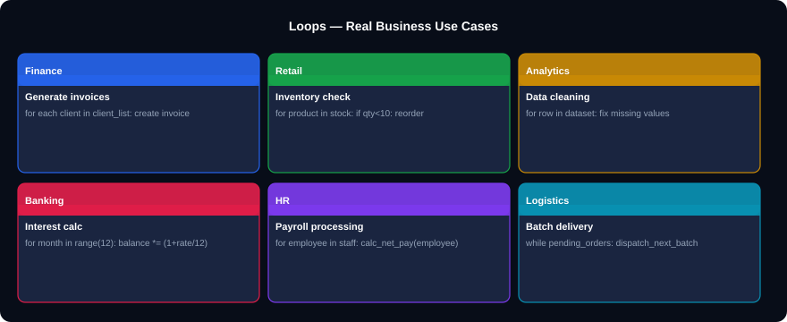
LOOPS IN BUSINESS — REAL APPLICATIONS
Notes:
Loop use cases. Every business process that repeats is a loop: batch invoice generation, inventory scanning, interest compounding, payroll processing. The while loop handles loan repayment simulation and retry-on-failure patterns. Loops are the engine of automation.

Slide 36
SECTION 06 CHALLENGE — LOOPS
⚡ CHALLENGE
⚡ CHALLENGE
Q1. Given:
regions = ['Lagos','Abuja','Kano','Rivers']
revenues = [4500000,2100000,1800000,1600000]
Print each as: '#1. Lagos: NGN 4,500,000'
Q2. Write a for loop that processes
scores = [45,78,0,91,-5,65,50,88]
and builds two lists: valid_scores (0-100)
and invalid_scores (out of range).
Answer:
Answer:
for i,(r,v) in enumerate(zip(regions,revenues),1):
print(f'#{i}. {r}: NGN {v:,}')
valid=[]; invalid=[]
for s in scores:
if 0 <= s <= 100: valid.append(s)
else: invalid.append(s)
# invalid: [0 is valid — range is 0 to 100]
⚡ CHALLENGE
⚡ CHALLENGE
Q3. Simulate a loan:
balance = 1,000,000
monthly rate = 1.5%, monthly payment = 50,000
How many months to pay off?
Print final month count.
Q4. Use a list comprehension to generate
invoice IDs from 1 to 20 in format:
['INV-001','INV-002',...,'INV-020']
Answer:
Answer:
bal=1_000_000; rate=0.015; pmt=50_000; m=0
while bal > 0:
bal = bal*(1+rate) - pmt
m += 1
print(m, 'months') # approx 25 months
[f'INV-{n:03d}' for n in range(1, 21)]
# :03d zero-pads to 3 digits
# ['INV-001','INV-002',...,'INV-020']
Notes:
Loop challenges. Q1 combines enumerate and zip — both in one line. Q2 builds two separate lists from one scan — the data validation pattern. Q3 (loan simulation) should be run live in Colab with students tracking the balance. Q4 uses f-string zero-padding (:03d) for professional invoice numbering.

Slide 37
07
Functions
Write once. Reuse everywhere. Test independently.

Slide 38
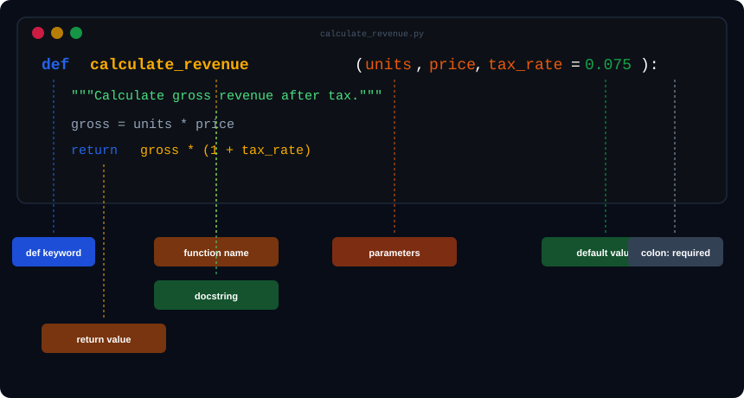
THE ANATOMY OF A PYTHON FUNCTION
Notes:
Function anatomy. Walk every labelled part: def keyword, function name (should be a verb describing what it does), parameters, default values, colon, docstring, body (indented 4 spaces), return value. A function without a return statement returns None. The example is calculate_revenue — a real business function.

Slide 39
FUNCTION PARAMETERS — ALL FIVE TYPES
parameters.py
Positional first, defaults after
# 1. Positional parameters (order matters)
def transfer(from_acct, to_acct, amount):
return f'Moved {amount} from {from_acct}'
transfer('ACC-001','ACC-002',50000) # positional
# 2. Default parameters
def apply_tax(amount, vat_rate=0.075):
return amount * (1 + vat_rate)
apply_tax(100_000) # uses 7.5% default
apply_tax(100_000, 0.05) # override to 5%
# 3. Keyword arguments
apply_tax(vat_rate=0.10, amount=200_000)
# 4. *args — any number of positionals
def total_sales(*amounts):
return sum(amounts)
total_sales(50000, 120000, 85000) # 255,000
# 5. **kwargs — any number of keyword args
def build_report(**metrics):
for name, value in metrics.items():
print(f" {name}: {value}")
build_report(revenue=5000000, profit=1200000,
margin_pct=24.0, customers=342)
def f(a, b=1, c=2) correct
def f(a=1, b) SyntaxError!
Default params must always come after positional.
*args gives a tuple
*amounts collects extra positional args into a tuple. You can loop over it or pass to sum().
**kwargs gives a dict
**metrics collects keyword args into a dictionary. Perfect for flexible report builders.
Call order
f(positional, keyword=value, *extras)
Keyword args can be in any order. Positional must match the function signature.
Notes:
Function parameters. The default vat_rate=0.075 example is immediately practical. *args for total_sales allows passing any number of amounts. **kwargs for build_report allows flexible metric names. Mention: Pandas and Matplotlib use **kwargs everywhere to pass optional styling parameters.

Slide 40
RETURN VALUES, LAMBDA, AND HIGHER-ORDER FUNCTIONS
lambdas.py
print vs return
# Multiple return values (tuple)
def revenue_summary(sales):
"""Return min, max, total and average."""
return min(sales), max(sales), sum(sales)
lo, hi, total = revenue_summary(revenues)
print(f"Range: {lo:,} - {hi:,}, Total: {total:,}")
# None return — side-effect only
def log_transaction(txn_id, amount):
print(f"[LOG] TXN-{txn_id}: NGN {amount:,}")
# No return → implicitly returns None
# Lambda — anonymous one-line function
get_tax = lambda amount: amount * 0.075
get_margin = lambda rev, cost: (rev-cost)/rev*100
get_tax(500_000) # 37,500
get_margin(500_000, 320_000) # 36.0
# Lambda in sorted() — sort by revenue
data = [('Lagos',4.5M),('Abuja',2.1M),('Kano',1.8M)]
ranked = sorted(data, key=lambda x: x[1], reverse=True)
# map() — apply function to every item
gross_amounts = [100000, 250000, 85000]
after_tax = list(map(lambda x: x*1.075, gross_amounts))
# [107500.0, 268750.0, 91375.0]
# filter() — keep items matching condition
high_value = list(filter(lambda x: x>100000, gross_amounts))
# [250000]
print() shows output on screen but the caller gets nothing back. return sends a value that can be stored, computed with, or passed to another function.
Functions are objects
You can store functions in variables, pass them as arguments (key=lambda), and return them from other functions.
Docstrings
Add a """description""" as the first line inside every function. It becomes help text: help(my_function) in Colab shows it instantly.
sorted() key parameter
The key= argument takes any function (often lambda) to extract the value to sort by. Used constantly in data ranking tasks.
Notes:
Return values and lambdas. The print vs return confusion causes more bugs in student code than anything else. Live demo: write log_transaction, call it, try to store the result and add to it — TypeError: 'NoneType'. Then fix with return. Lambda + sorted is the most common real-world lambda usage.

Slide 41
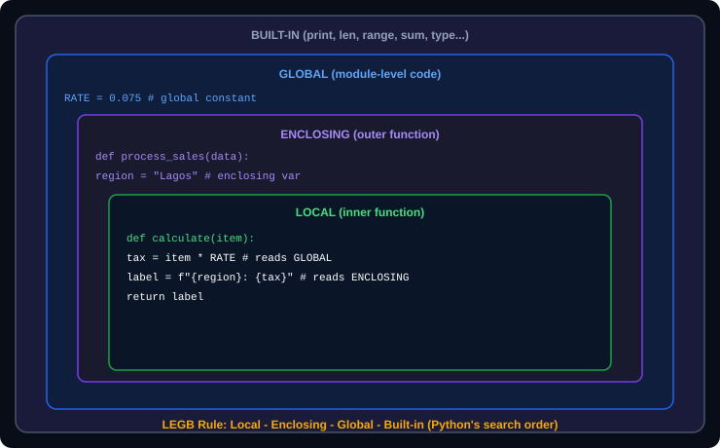
SCOPE — WHERE VARIABLES LIVE (LEGB RULE)
scope.py
# Global vs Local
TAX_RATE = 0.075 # global constant
def calculate_total(amount):
vat = amount * TAX_RATE # reads global
return amount + vat
print(vat) # NameError: vat is LOCAL
# global keyword (avoid — use return instead)
total_revenue = 0
def add_sale(amount):
global total_revenue # declare intent
total_revenue += amount
# BETTER APPROACH: return and update
def add_sale(current, amount):
return current + amount
total = add_sale(total, 50_000)
# Constants: ALL_CAPS signals global
MAX_LOAN_AMOUNT = 10_000_000
MIN_CREDIT_SCORE = 650
DEFAULT_VAT = 0.075
Notes:
Scope. LEGB = Local, Enclosing, Global, Built-in. The key message: avoid global. Global variables make code hard to test and debug. Instead, pass values in as arguments and return results. The convention ALL_CAPS for constants (TAX_RATE, MAX_LOAN_AMOUNT) is important for readability.

Slide 42
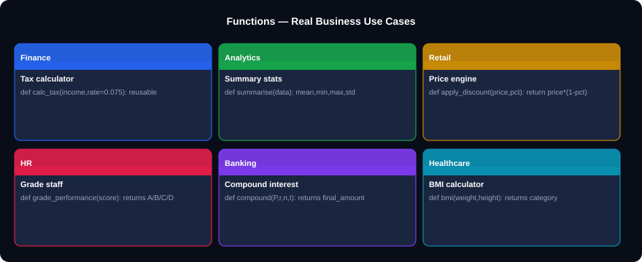
FUNCTIONS IN BUSINESS — REAL APPLICATIONS
Notes:
Function use cases. Every business calculation that runs more than once should be a function. Tax calculation, discount engine, performance grading, compound interest — all become one-line calls after the function is defined. Functions also make testing possible: test with known inputs, verify outputs.

Slide 43
SECTION 07 CHALLENGE — FUNCTIONS
⚡ CHALLENGE
⚡ CHALLENGE
Q1. Write a function 'classify_customer'
that takes (balance, months_active) and returns:
'VIP' if balance>=500,000 and months>=12
'Active' if balance>0
'Inactive' otherwise
Q2. Write a function 'summarise_sales(*amounts)'
that accepts any number of sales amounts and returns a dict with total, average, minimum, maximum.
Answer:
Answer:
def classify_customer(balance, months_active):
if balance>=500_000 and months_active>=12:
return 'VIP'
elif balance > 0:
return 'Active'
return 'Inactive'
def summarise_sales(*amounts):
return {'total':sum(amounts),
'avg':sum(amounts)/len(amounts),
'min':min(amounts),'max':max(amounts)}
⚡ CHALLENGE
⚡ CHALLENGE
Q3. What is the output and why?
rate = 0.15
def update_rate():
rate = 0.20
return rate
update_rate()
print(rate)
Q4. Sort this list of tuples by revenue (index 1) descending:
regions = [('Kano',1.8),('Lagos',4.5),('Abuja',2.1)]
Answer:
Answer:
Output: 0.15
The function creates a LOCAL rate=0.20.
The global rate is never changed.
To update global: use 'global rate' or return and reassign.
sorted(regions, key=lambda r: r[1], reverse=True)
# [('Lagos',4.5),('Abuja',2.1),('Kano',1.8)]
# lambda extracts the revenue for comparison
Notes:
Function challenges. Q1 (classify_customer) is a real CRM segmentation function. Q2 (*args with dict return) is a common data summary utility. Q3 (scope) — the output is always 0.15, surprising many students who expect 0.20. Q4 (lambda sort) is the most practically used lambda pattern in data work.

Slide 44
08
Practical Projects and Exercise Bank
Apply everything. Build real programs.

Slide 45
PRACTICAL PROJECT 1 — SALES PERFORMANCE REPORT
sales_report.py
# SALES PERFORMANCE REPORT — combines types, dicts, lists, loops, functions, conditionals
def classify(revenue):
if revenue >= 5_000_000: return "Excellent"
elif revenue >= 2_000_000: return "Good"
elif revenue >= 1_000_000: return "Average"
else: return "Below Target"
sales_data = [
{"region":"Lagos", "q1":4.5, "q2":5.2, "q3":4.8, "q4":6.1},
{"region":"Abuja", "q1":2.1, "q2":2.4, "q3":2.0, "q4":2.8},
{"region":"Kano", "q1":1.8, "q2":1.6, "q3":2.1, "q4":1.9},
{"region":"Port Harcourt", "q1":1.6, "q2":1.9, "q3":1.5, "q4":2.2},
{"region":"Enugu", "q1":0.9, "q2":1.1, "q3":0.8, "q4":1.4},
]
print(f"{'REGION':<18}{'Q1':>6}{'Q2':>6}{'Q3':>6}{'Q4':>6}{'TOTAL':>9}{'RATING':>14}")
print('='*65)
all_totals = []
for row in sales_data:
q_total = row['q1']+row['q2']+row['q3']+row['q4']
rating = classify(q_total * 1_000_000)
all_totals.append(q_total)
print(f"{row['region']:<18}{row['q1']:>6.1f}{row['q2']:>6.1f}{row['q3']:>6.1f}{row['q4']:>6.1f}{q_total:>9.1f}{rating:>14}")
print('='*65)
top = max(sales_data, key=lambda x: x['q1']+x['q2']+x['q3']+x['q4'])
print(f"Top Region: {top['region']} | Grand Total: {sum(all_totals):.1f}M")
Notes:
Practical Project 1. This synthesises everything: a classify() function, a list of dicts as the data source, a for loop to process each region, f-string column alignment, lambda for finding the max. Run this live in Colab step by step. Let students extend it: add a chart using matplotlib (one extra line: plt.bar(regions, totals)).

Slide 46
PRACTICAL PROJECT 2 — INVOICE GENERATOR
invoice_generator.py
# INVOICE GENERATOR — complete business tool
def generate_invoice(client, items, vat_rate=0.075, discount_pct=0.0):
"""Generate a formatted invoice dict for a client."""
subtotal = sum(qty * price for qty, _, price in items)
discount = subtotal * discount_pct
net = subtotal - discount
vat = net * vat_rate
total = net + vat
return {"client":client,"subtotal":subtotal,"discount":discount,
"net":net,"vat":vat,"total":total,"items":items}
def print_invoice(inv):
print(f"\n{"="*50}")
print(f" INVOICE — {inv['client']}")
print(f"{"="*50}")
for qty, desc, price in inv['items']:
print(f" {qty}x {desc:<20} @ {price:>10,} = {qty*price:>12,}")
print(f" {"-"*48}")
print(f" {"Subtotal:":<30} NGN {inv['subtotal']:>12,.0f}")
print(f" {"Discount:":<30} NGN {inv['discount']:>12,.0f}")
print(f" {"VAT (7.5%):":<30} NGN {inv['vat']:>12,.0f}")
print(f" {"TOTAL PAYABLE:":<30} NGN {inv['total']:>12,.0f}")
# --- Run it ---
order = [(5,'Laptop Pro 15',450_000),(10,'USB-C Hub',15_000),(3,'Monitor 27in',200_000)]
inv = generate_invoice('TechVentures Ltd', order, discount_pct=0.05)
print_invoice(inv)
Notes:
Practical Project 2. The invoice generator demonstrates real-world function design: a pure calculation function (generate_invoice) separated from a display function (print_invoice). This separation of concerns is the first professional programming habit students should develop.

Slide 47
30
EXERCISES
Exercise Bank
All exercises run in Google Colab. Cover the answer box and attempt each one independently.
Beginner
Q1-Q10
Single-concept questions. Each tests one idea from one section.
Intermediate
Q11-Q20
Multi-concept. Combine two or more topics per problem.
Advanced
Q21-Q30
Full programs. Design and build a complete solution from scratch.
Notes:
Exercise bank introduction. Q1-10 are suitable for in-class timed exercises (3-5 minutes each). Q11-20 work well as homework. Q21-30 are take-home projects or assessment tasks. All have context in the Nigerian business environment. All run in Google Colab with zero setup.

Slide 48
BEGINNER EXERCISES Q1 – Q10
Q1
Create 5 variables: a product name (str), quantity (int), unit price (float), in_stock (bool), and last_order (None). Print each with type().
Q2
A store sells 350 units at NGN 8,500 each. VAT is 7.5%. Calculate and print the total revenue after VAT using f-string with comma formatting.
Q3
Take a product code string 'SKU-2024-00142'. Extract and print: the prefix (SKU), the year (2024), and the sequence number (00142) using slicing.
Q4
Create a list of 6 product names. Print the first, the last, and reverse the list using slicing. Add one item to the end and remove the third item.
Q5
Create a dict for one customer: id, name, region, balance, active. Print every key-value pair using a for loop and .items().
Q6
Write an if/elif/else block that classifies credit score into: 750+ Excellent, 700-749 Good, 650-699 Fair, below 650 Poor. Test with score=715.
Q7
Use a for loop with range to print a 9-times multiplication table (9x1=9 through 9x12=108).
Q8
Write a function 'net_pay(gross, tax_rate=0.15, pension=0.08)' that returns the net pay. Test with gross=450,000.
Q9
Use a while loop to simulate depositing NGN 10,000 per month into an account until the balance reaches 200,000. Print how many months it takes.
Q10
Given a list of region names with duplicates, use a set to find the unique regions, then convert back to a sorted list.
Notes:
Beginner exercises — all business-themed. Q2 tests type conversion and f-string formatting. Q3 tests string slicing with a real product code. Q8 tests function with multiple default parameters. Q9 tests while loop accumulation. Q10 tests set deduplication.

Slide 49
INTERMEDIATE EXERCISES Q11 – Q20
Q11
Write a function that takes a list of sale amounts and returns a dict with total, average, minimum, maximum, and count.
Q12
Given a list of transaction dicts (each with 'amount' and 'type': 'credit' or 'debit'), compute the closing balance starting from 0.
Q13
Use a list comprehension to extract the 4-digit year from a list of product codes like ['SKU-2024-001','SKU-2023-042','SKU-2022-108'].
Q14
Build a frequency counter: given a list of region names, return a dict showing how many times each region appears.
Q15
Write 'is_valid_id(emp_id)' that returns True only if the string has exactly 8 characters, starts with 'E', and ends with a digit.
Q16
Write a loan amortisation function: loan_schedule(principal, monthly_rate, payment) that returns the number of months to payoff.
Q17
Given a list of dicts with 'name' and 'revenue', sort by revenue descending without modifying the original list.
Q18
Write a function 'apply_bracket_tax(income)': 0-300k=0%, 300k-1M=7.5%, 1M-5M=15%, above 5M=22.5%. Return the tax amount.
Q19
Use filter() and lambda to return only products with price above 50,000 from a list of (product, price) tuples.
Q20
Write a function 'deduplicate_orders(orders)' that removes duplicate order IDs from a list and returns the sorted unique list.
Notes:
Intermediate exercises — real business logic. Q12 (running balance) is a bank statement simulation. Q14 (frequency counter) is regional sales breakdown. Q16 (loan amortisation) is a real finance function. Q18 (bracket tax) mirrors PAYE tax calculation systems used in Nigerian payroll.

Slide 50
ADVANCED EXERCISES Q21 – Q30
Q21
Build a complete INVENTORY SYSTEM with functions: add_product, remove_product, update_stock, check_reorder, generate_reorder_list. Use a dict of dicts.
Q22
Build a PAYROLL CALCULATOR: for each employee dict (name, gross, grade, years), calculate net pay with PAYE bracket tax, pension 8%, NHF 2.5%, and generate a payslip.
Q23
Write a CUSTOMER SEGMENTATION system: classify each customer by RFM (Recency, Frequency, Monetary) scoring into VIP, Active, At-Risk, or Lapsed.
Q24
Build a LOAN COMPARISON TOOL: given principal, compare 3 loan options (different rates and tenors) — show total cost and monthly payment for each.
Q25
Write a CSV PARSER: given a multi-line string in CSV format (first line = headers), parse into a list of dicts and compute summary stats per numeric column.
Q26
Build a GRADE BOOK SYSTEM: register students, record marks per subject, compute GPA, rank students, and identify those at risk (GPA < 2.0).
Q27
Implement a SIMPLE LEDGER: post debit and credit entries, compute running balance, detect anomalies (single entry > 10% of total), print statement.
Q28
Write a BUDGET TRACKER: add income and expense categories, compare actual vs budget, flag overspent categories, calculate savings rate.
Q29
Build a TEXT ANALYTICS tool: given a business report as a string, count word frequency, find the top 10 words (excluding stop words), compute average sentence length.
Q30
Write a DISCOUNT ENGINE: given product catalogue and customer tier (Bronze/Silver/Gold/Platinum), apply tiered discounts, apply bulk quantity discounts, and print a final order summary.
Notes:
Advanced exercises — these are real-world systems, each requiring 45-90 minutes. Q22 (payroll) directly mirrors Nigerian PAYE tax structure. Q23 (RFM segmentation) is a standard CRM technique used by banks and telecoms. Q25 (CSV parser) bridges pure Python to Pandas. Q30 (discount engine) is a complete pricing system.

Slide 51
PYTHON FUNDAMENTALS — QUICK REFERENCE CHEAT SHEET
Data Types
String ops
List ops
int float str bool None
type(x) int() float() str() bool()
"str"[0] [1:4] [::-1] len(s)
.upper() .split() .strip() f"{var}"
[].append() .pop() .sort() .index()
sorted(lst) len(lst) x in lst
Dict ops
Set ops
if / elif / else
{}.get(k,def) .items() .keys()
del d[k] k in d len(d)
set() .add() | & - ^
x in s len(s) frozenset()
if cond:
block
elif cond:
block
else:
block
for loop
while loop
Function
for x in lst:
for i,v in enumerate(lst,1):
for a,b in zip(lst1,lst2):
while cond:
block
break / continue
def name(a, b=default, *args, **kw):
"""docstring"""
return value
Lambda
Comprehension
Scope
f = lambda x: x * 2
sorted(lst, key=lambda x: x[1])
[expr for x in lst if cond]
{k:v for k,v in d.items()}
L → E → G → B (LEGB)
global x (avoid — use return)
Notes:
Cheat sheet. Recommend printing this for students. It covers all essential syntax in a compact reference. One A4 page, both sides, laminated — a physical coding reference card students can keep at their desk.

Slide 52
🐍
Python Data
Fundamentals
Complete Teaching Deck | Google Colab
Kajola Gbenga Adewale
Data Analytics Expert
Next step: Work through the 30 exercises in Colab,
then move to NumPy, Pandas, and Matplotlib for data analysis.
You can now:
Work with all Python data types
✓ Types
✓ Operators
Operate on numbers, text, booleans
Build and query lists, dicts, sets
✓ Conditionals
✓ Structures
Write conditional business logic
✓ Loops
✓ Functions
Automate with for and while loops
Write reusable, testable functions
Notes:
Closing slide. End with energy and specificity. Every concept covered today is a building block for data analytics. When they open Pandas next week, they will recognise: DataFrames are dictionaries of lists. Groupby returns dictionary-like objects. Filtering is conditional logic. Everything connects.

